Slide 1
Introduction to Quantum Computing
Dr. Rohan Sharma
Assistant Professor
Department of CSE

Slide 2
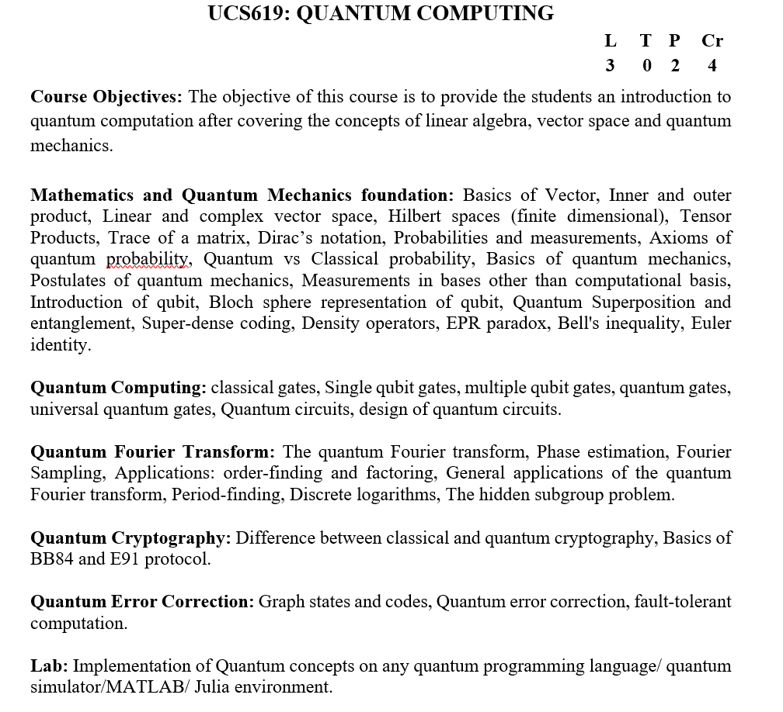
Syllabus

Slide 3
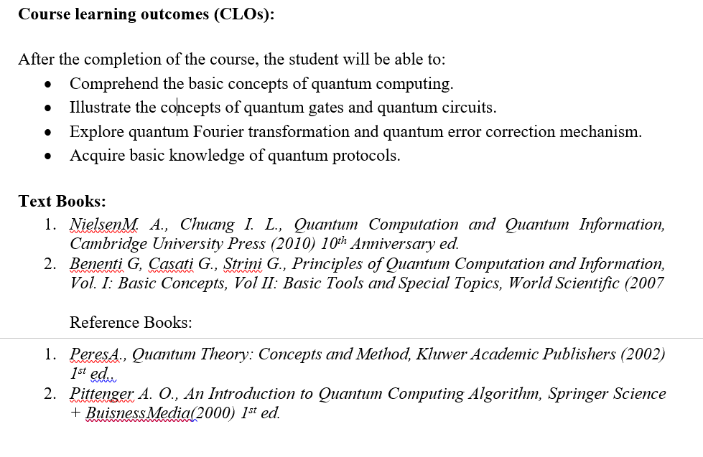
Syllabus

Slide 4
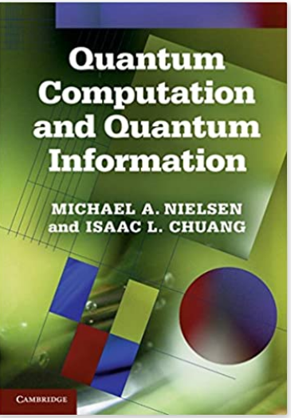
Books

Slide 5
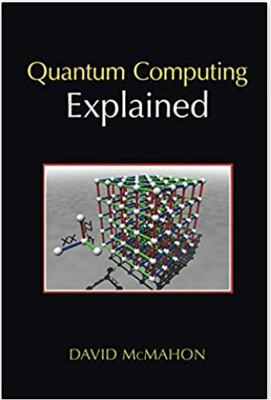
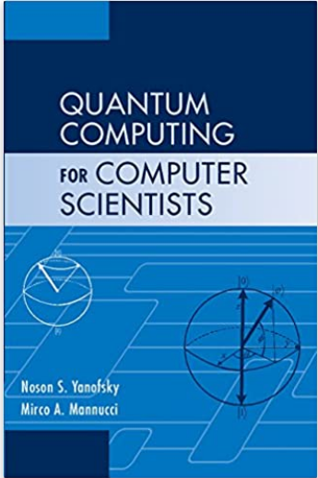
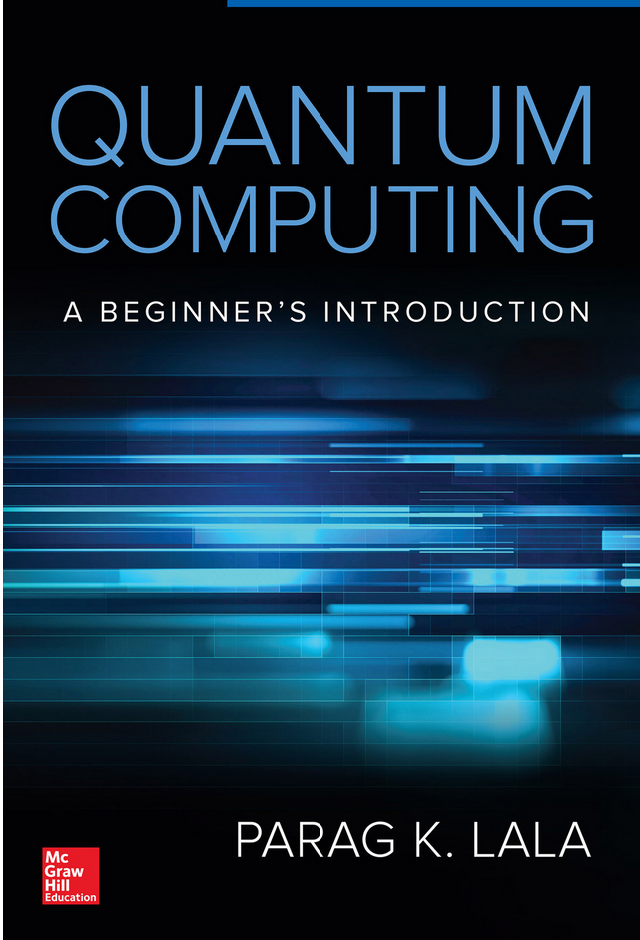
Books

Slide 6
OUTLINE
Why Quantum Computing?
What is Quantum Computing?
History
Quantum Weirdness
Quantum Properties
Quantum Devices

Slide 7
Why Quantum Computing?

Slide 8
Transistor Density
Transistors per chip
?
10⁹
10⁸
Pentium
Pro
80786
10⁷
80486
Pentium
10⁶
80386
80286
10⁵
8086
8080
10⁴
4004
10³
1970
1975
1980
1985
1990
1995
2000
2005
2010
Year

Slide 9
Transistor Size
Electrons per device
10⁴
(4M)
(16M)
(64M)
10³
(256M)
(1G)
(Transistors per chip)
10²
(4G)
(16G)
10¹
?
10⁰
1 electron/transistor
10⁻¹
1985
1990
1995
2000
2005
2010
2015
2020
Year

Slide 10
Why Quantum Computing?
By 2020 it is being believed that it would hit natural limits on the size of transistors
Max out on the number of transistors per chip
Reach the minimum size for transistors
Reach the limit of speed for devices
Eventually, all computing will be done using some sort of alternative structure
DNA
Cellular Automaton
Quantum

Slide 11
What is Quantum Computing?

Slide 12
Introduction
The common characteristic of any digital computer is that it stores bits
Bits represent the state of some physical system
Electronic computers use voltage levels to represent bits

Slide 13
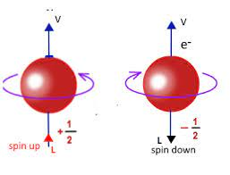
Introduction
The common characteristic of any digital computer is that it stores bits
Bits represent the state of some physical system
Electronic computers use voltage levels to represent bits
Quantum systems possess properties that allow the encoding of bits as physical states
Direction of spin of an electron
The direction of polarization of a photon
The energy level of an excited atom

Slide 14
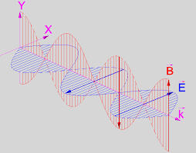
Introduction
The common characteristic of any digital computer is that it stores bits
Bits represent the state of some physical system
Electronic computers use voltage levels to represent bits
Quantum systems possess properties that allow the encoding of bits as physical states
Direction of spin of an electron
The direction of polarization of a photon
The energy level of an excited atom

Slide 15
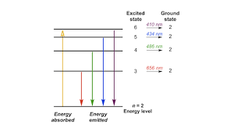
Introduction
The common characteristic of any digital computer is that it stores bits
Bits represent the state of some physical system
Electronic computers use voltage levels to represent bits
Quantum systems possess properties that allow the encoding of bits as physical states
Direction of spin of an electron
The direction of polarization of a photon
The energy level of an excited atom

Slide 16
Spin States
An electron is always in one of two spin states
“spin up” – the spin is parallel to the particle axis
“spin down” – the spin is antiparallel to the particle axis
Notation:
Spin up:
Spin down:

Slide 17
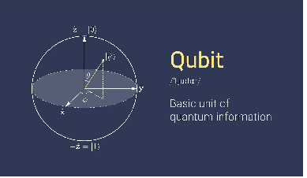

qubit
¹https://www.mouser.com/blog/a-bit-about-connecting-qubits-quantum-computing
A qubit is a bit represented by a quantum system
By convention:
A qubit state 0 is the spin up state
A qubit state 1 is the spin down state
0
1

Slide 18
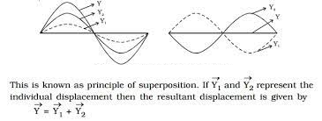
Definitions
A qubit is governed by the laws of quantum physics
While a quantum system can be in one of a discrete set of states, it call also be in a blend of states called a superposition
That is a qubit can be in:
|c₀|²+|c₁|² = 1
0
c₀ + c₁
1
0
1

Slide 19
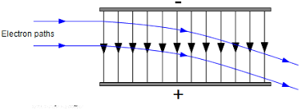
Measurement
If a qubit is realized by the spin of an electron, it is possible to measure the qubit value by passing the electron through a magnetic field
If the qubit encodes a |0> then it will be deflected upward
If the qubit encodes a |1> then it will be deflected downward

Slide 20
Superposition Measurement
If the qubit is in a superposition state it cannot determine if it will deflect up or down
However, the probability of each possible deflection can be found
Probability of
0
c₀
2
Probability of
1
c₁
2
c₀ + c₁
0
1

Slide 21
Quantum Computing History

Slide 22
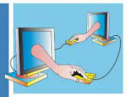
History
In the 1970’s Fredkin, Toffoli, Bennett and others began to look into the possibility of reversible computation to avoid power loss.
Since quantum mechanics is reversible, a possible link between computing and quantum devices was suggested

Slide 23
History
In the 1970’s Fredkin, Toffoli, Bennett and others began to look into the possibility of reversible computation to avoid power loss.
Since quantum mechanics is reversible, a possible link between computing and quantum devices was suggested
Some early work on quantum computation occurred in the 80’s
Benioff 1980,1982 explored a connection between quantum systems and a Turing machine
Feynman 1982, 1986 suggested that quantum systems could simulate reversible digital circuits
Deutsch 1985 defined a quantum level XOR mechanism

Slide 24
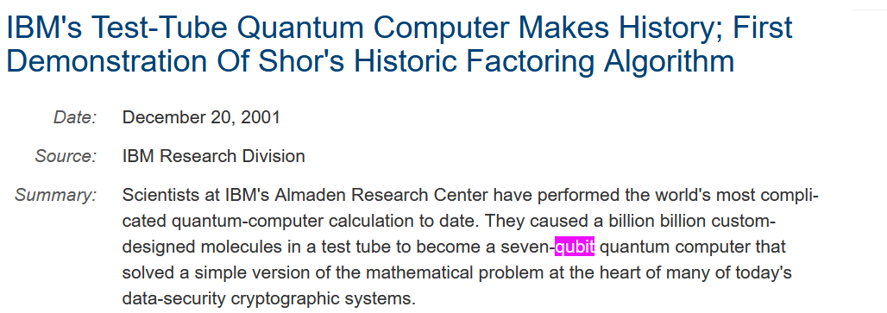
Existing Quantum Computers
IBM both have working liquid NMR quantum computers with 3 – 6 qubit registers.
NIST, LANL and others using an Ion Trap method have achieved a single CONTROLLED NOT.

Slide 25
Quantum Weirdness

Slide 26
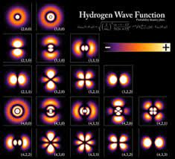
Quantum Mechanics
One of the unusual features of Quantum Mechanics is the interaction between an event and its measurement
Measurement changes the state of a quantum system
Measurement of the superposition state of a qubit forces it into one of the qubit states in an unpredictable manner

Slide 27
Comparison I
Compare qubits to classical bits
Assumption Classical Quantum
A bit always has a
definite value
True
False, a qubit need not have a
definite value until the moment
after it is observed
A bit can only be 0 or 1
True
False, a qubit can be in a
superposition of 0 and 1
simultaneously
A bit can be copied without
affecting its value
True
False, a qubit in an unknown
state cannot be copied without
disrupting its state
A bit can be read without
affecting its value
True
False, reading a qubit that is
initially in a superposition will
change the value of the qubit

Slide 28
Comparison II
Assumption Classical Quantum
Reading one bit has no effect
on another unread bit
True
False, if the qubit being read is
entangled with another qubit
reading one will affect the other
To compute the result of a
computation you must run
the computer
True
False, if you have a quantum
computer that could perform the
computation if it were run, then
the answer can be obtained even
though the computer is not run

Slide 29
Quantum Phenomena

Slide 30
Quantum Phenomena
There are five quantum phenomena that make quantum computing weird
Superposition
Interference
Entanglement
Non-determinism
Non-clonability

Slide 31
Superposition
The Principal of Superposition states if a quantum system can be measured to be in one of a number of states then it can also exist in a blend of all its states simultaneously
RESULT: An n-bit qubit register can be in all 2^{n} states at once
Massively parallel operations

Slide 32
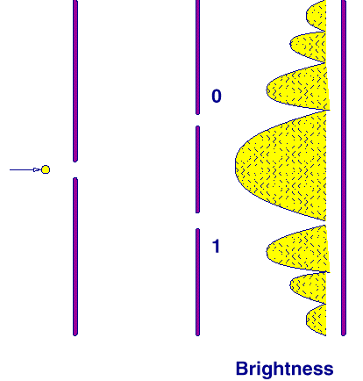
Interference
We see interference patterns when light shines through multiple slits
This is a quantum phenomena which is also present in quantum computers
A quantum computer can operate on several inputs at once, the results interfere with each other producing a collective result

Slide 33
Entanglement
If two or more qubits are made to interact, they can emerge from the interaction in a joint quantum state which is different from any combination of the individual quantum states
RESULT: If two entangled qubits are separated by any distance and one of them is measured then the other, at the same instant, enters a predictable state

Slide 34
Non-Determinism
Quantum non-determinism refers to the condition of unpredictability
If a quantum system is in a superposition state and then measured, the measured state can not be predicted.

Slide 35
Non-Clonability
It is impossible to copy an unknown quantum state exactly
If you asked a friend to prepare a qubit in a superposition state without telling you which superposition state, then you could not make a perfect copy of the qubit
Useful in quantum cryptology

Slide 36
Quantum Devices

Slide 37
Quantum Register
Any computer requires a memory to store data for input or output
A quantum memory can be thought of as a set of qubits
A 2-bit quantum register would contain the superposition of 4 states:
c₀
+
c₁
+
c₂
+
c₃

Slide 38
Register Superposition
Until it is read, a quantum n-bit register can be in a superposition of all 2^{n} states
This allows a quantum computer to work on all possible inputs at the same time
However, when we read a quantum register it is forced into only 1 state
REQUIRE: a clever method that will allow a quantum register to evolve into a superposition of only acceptable solutions

Slide 39
Prepare-Evolve-Measure
Classical computers operate on a Fetch-Execute cycle
Quantum computers operate on a PREPARE-EVOLVE-MEASURE cycle
Prepare: place a quantum memory register in an initial state (usually all |0>)
Evolve: step the computer through a set of states which result in a superposition of acceptable solutions in the register
Measure: measure the register to find one of the acceptable answers

Slide 40
Quantum Gates
Quantum logic gates are similar in overall function to digital logic gates
They perform logic operations such as NOT, AND, OR, . . .
However, quantum logic gates must have as many outputs as there are inputs
Because they must be “reversible”

Slide 41
Quantum NOT
The quantum not gate operates on a single qubit defined by:
U_{not}
0
=
1
U_{not}
1
=
0
NOT Operation

Slide 42
Square Root of NOT
The quantum inverter is actually implemented using two special NOT gates defined by:
U
U
0
=
1
NOT
NOT
U
U
1
=
0
NOT
NOT
This is kind of gate is unique to quantum computing.
There is no way that two applications of any digital
gate can produce the inverse operation

Slide 43
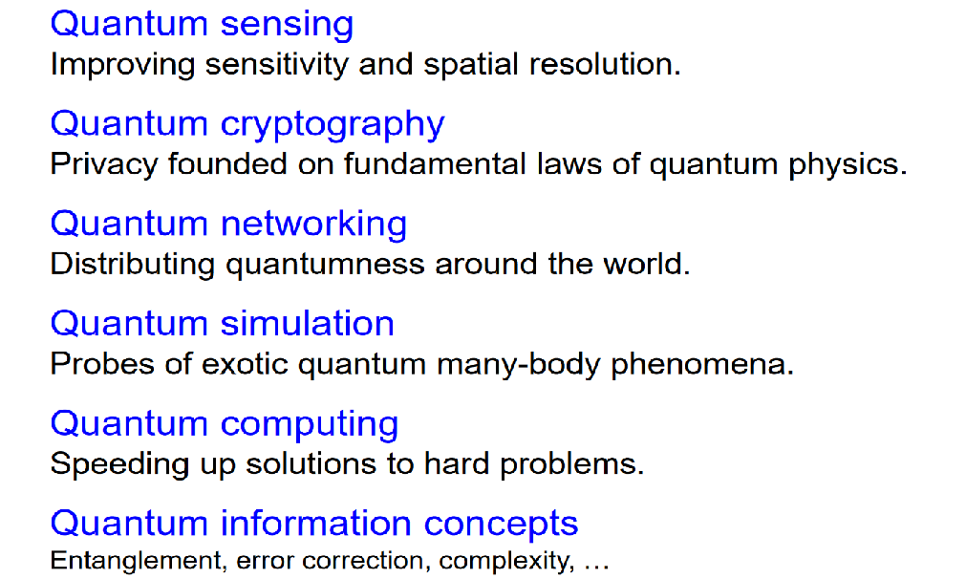
Some uses in Quantum World

Slide 44
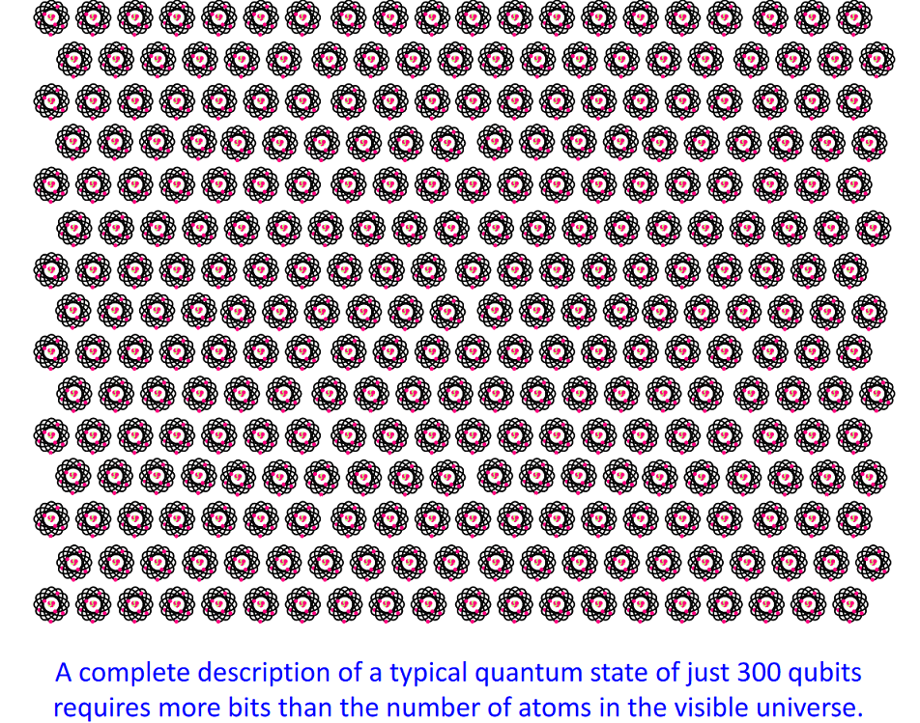
Some interesting facts

Slide 45
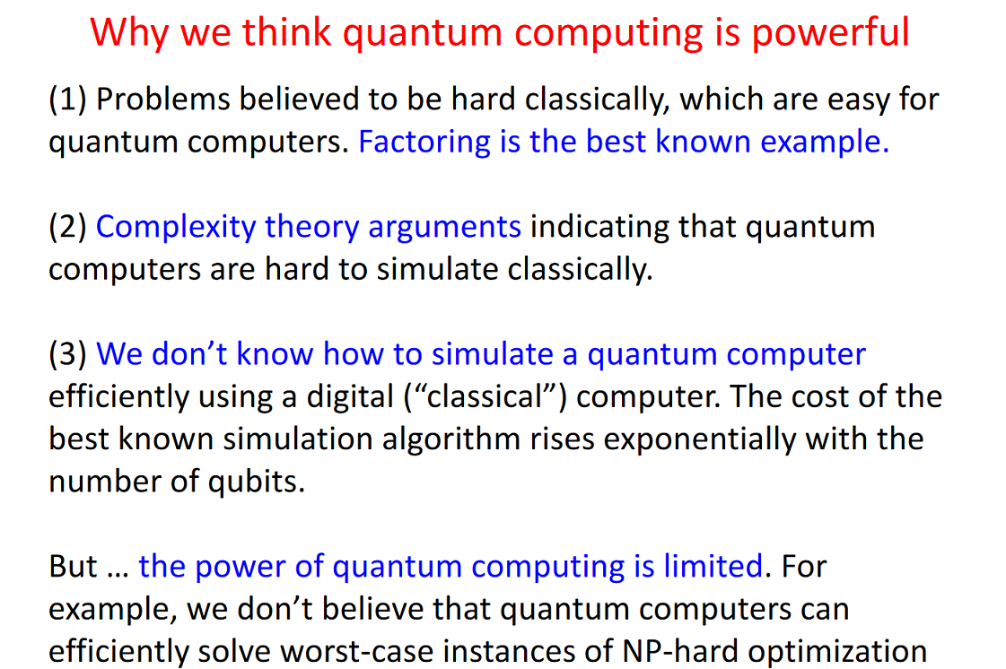

Slide 46
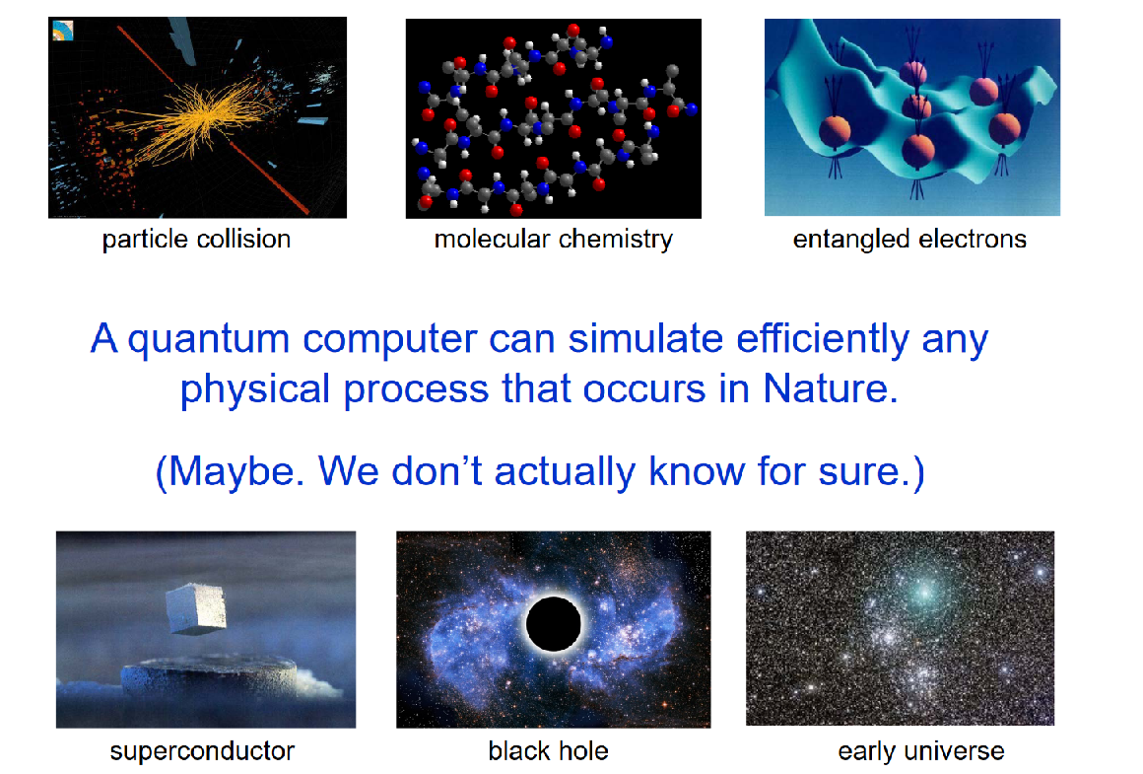

Slide 47
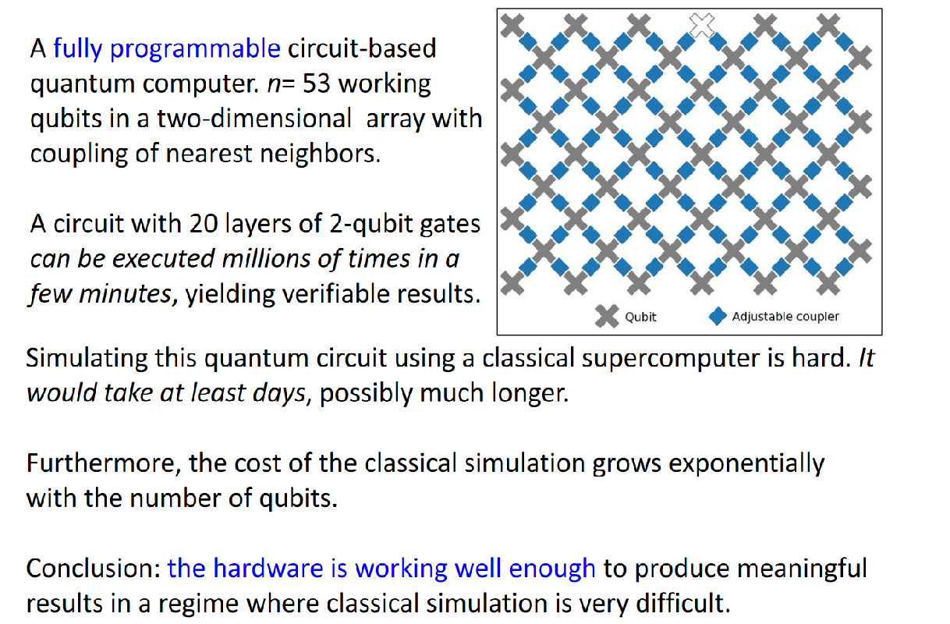

Slide 48
Thank you

